Slide 1
Ultimate Hangman
P1
L1
G1
A1
M1
E1
Y2
Notes:
Cole?

Slide 2
OUR TEAM
Dorrin Ashrafi
Tian Zhang
Erasmia Poulassichidis
Cole Irish
Alex Recana
S1
U1
C1
C1
E1
S1
I1
S1
Notes:
Cole?

Slide 3
Contributions
Dorrin Ashrafi - Navbar, Hangman (Difficulty mode, Hint Pop-up,Game Functions, Restart Button), Login/Registration Errors
Tian Zhang - Word Database, Dictionary, Registration, Leaderboard, SQL
Erasmia Poulassichidis - Game Functions, Test Cases, Settings Page, Hint Pop Up, Keyboard, Restart Button,Login/ Registration errors
Cole Irish - Render, Login, Home page, Leaderboard and Score
Alex Recana - Logout, Game Over, Styling, Hangman/Settings implementation
S1
U1
C1
C1
E1
S1
I1
S1
Notes:
Everyone

Slide 4

Description of the Project
Our project is a versatile and multi-faceted application that offers unique, wonderful, and engaging functionalities including a dictionary that utilizes an API to fetch and display information to users, a unique take on the Hangman game, a database that stores user usage statistics and details, along with great features such as adjusting the theme of the display along with difficulty settings.
T1
R1
Y1
Notes:
alex

Slide 5
Tools Used
PostgreSQL
NodeJS
JavaScript
Bootstrap
HTML
Python
Handlebars
Visual Studio Code
CSS
Github
Mocha
Render
T
O
O
L
S
Notes:
Dorrin

Slide 6
Tool Utilization and Versatility
How useful was each tool?
PostgreSQL - Our database. Used to fetch and store data. 5 stars.
NodeJS - Pretty Much Necessary. 5 stars. Used to communicate between front-end and back-end and fetch and send information back to users when they make requests.
JavaScript - Also pretty much necessary. 5 stars. Javascript is the backbones of the back-end, we used it for the game, endpoints, some front-end functionalities, etc.
Bootstrap - 4.5 stars. Easy to use and great tool that made our website look good as well as give some HTML functionalities
Notes:
Tian

Slide 7
Tool Utilization and Versatility Cont.
How useful was each tool?
CSS - Used for formatting and styling. 4 stars.
HTML - Provides the skeleton of our website. The structure of our web pages. 5 stars.
Handlebars - Extremely useful for formatting HTML. Can build and structure the pages using the data returned from API Calls. 5 stars.
Github - We used this exclusively for the development of our project. This version control system allowed us to work on the project together and allowed us to make separate branches to work on separate features. 5 stars.
Mocha - Used for testing features. 4 stars.
Render - Used to host our website. 4 stars.
Python - Used to extract data for our database. 4 stars.
Notes:
alex

Slide 8
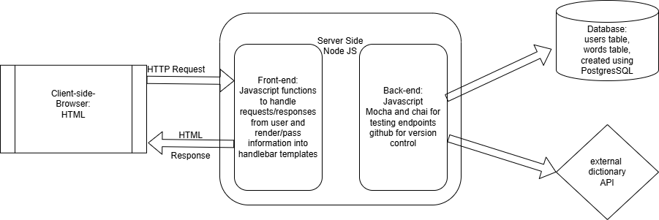
Architecture Diagram
Notes:
erasmia

Slide 9
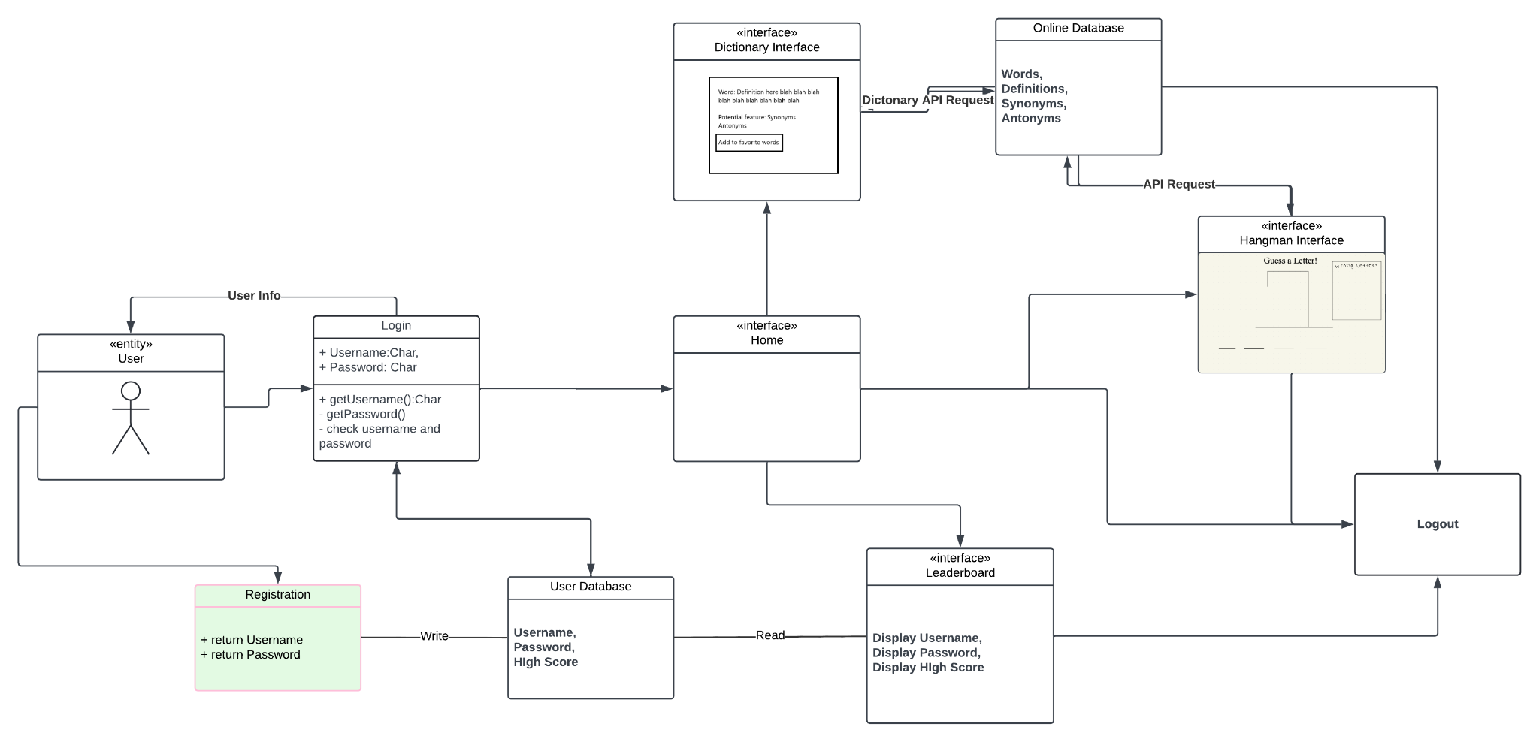
Ultimate Hangman Use Case Diagram
Architecture Diagram
This diagram should include a detailed diagram depcting the architecture used for your application and the flow of data across the different parts of the architecture. Please find below a sample architecture diagram. Tailor it to specifically suit your project. It must include the tools you used for each layer of the architecture. Make sure to list the names of the external APIs(if any) as well.
A1
B1
C1
D1
E1
F1
G1
H1
I1
J1
K1
L1
M1
N1
O1
P1
Q1
R1
S1
T1
U1
V1
W1
X1
Y1
Z1
Notes:
Cole

Slide 10

Encountered Challenges
Bugs :( Some of the bugs that we encountered while creating the project were extremely difficult to find and fix.
Complexity: Some of the features that we implemented were extremely complex and challenging to make. Examples include the actual game itself and some endpoints which were tricky to make.
Time restraints. Due to the fact that the allocated time for the project was merely four weeks along with the fact that we also had to balance time with other projects and things in life, this was a great challenge.
Despite all the challenges, we loved working on our project and it turned out to be amazing!!!
Notes:
Tian

Slide 11
Future Improvements and Enhancements
P1
Being able to resume and save active game sessions if you navigate away from the playHangman page or logout and sign back in
Being able to add friends and play multiplayer
Sound effects like after you lose/win or after a correct guess
Different types of game modes, like
Putting a timer and seeing how many words you can get within the minute
Awarding higher scores for speed
A pictionary mode, where the word hint is a picture related to the word that they have to guess
R1
E1
M1
I1
U1
S1
U1
R1
P1
R1
I1
S1
E1
M1
Notes:
erasmia

Slide 12
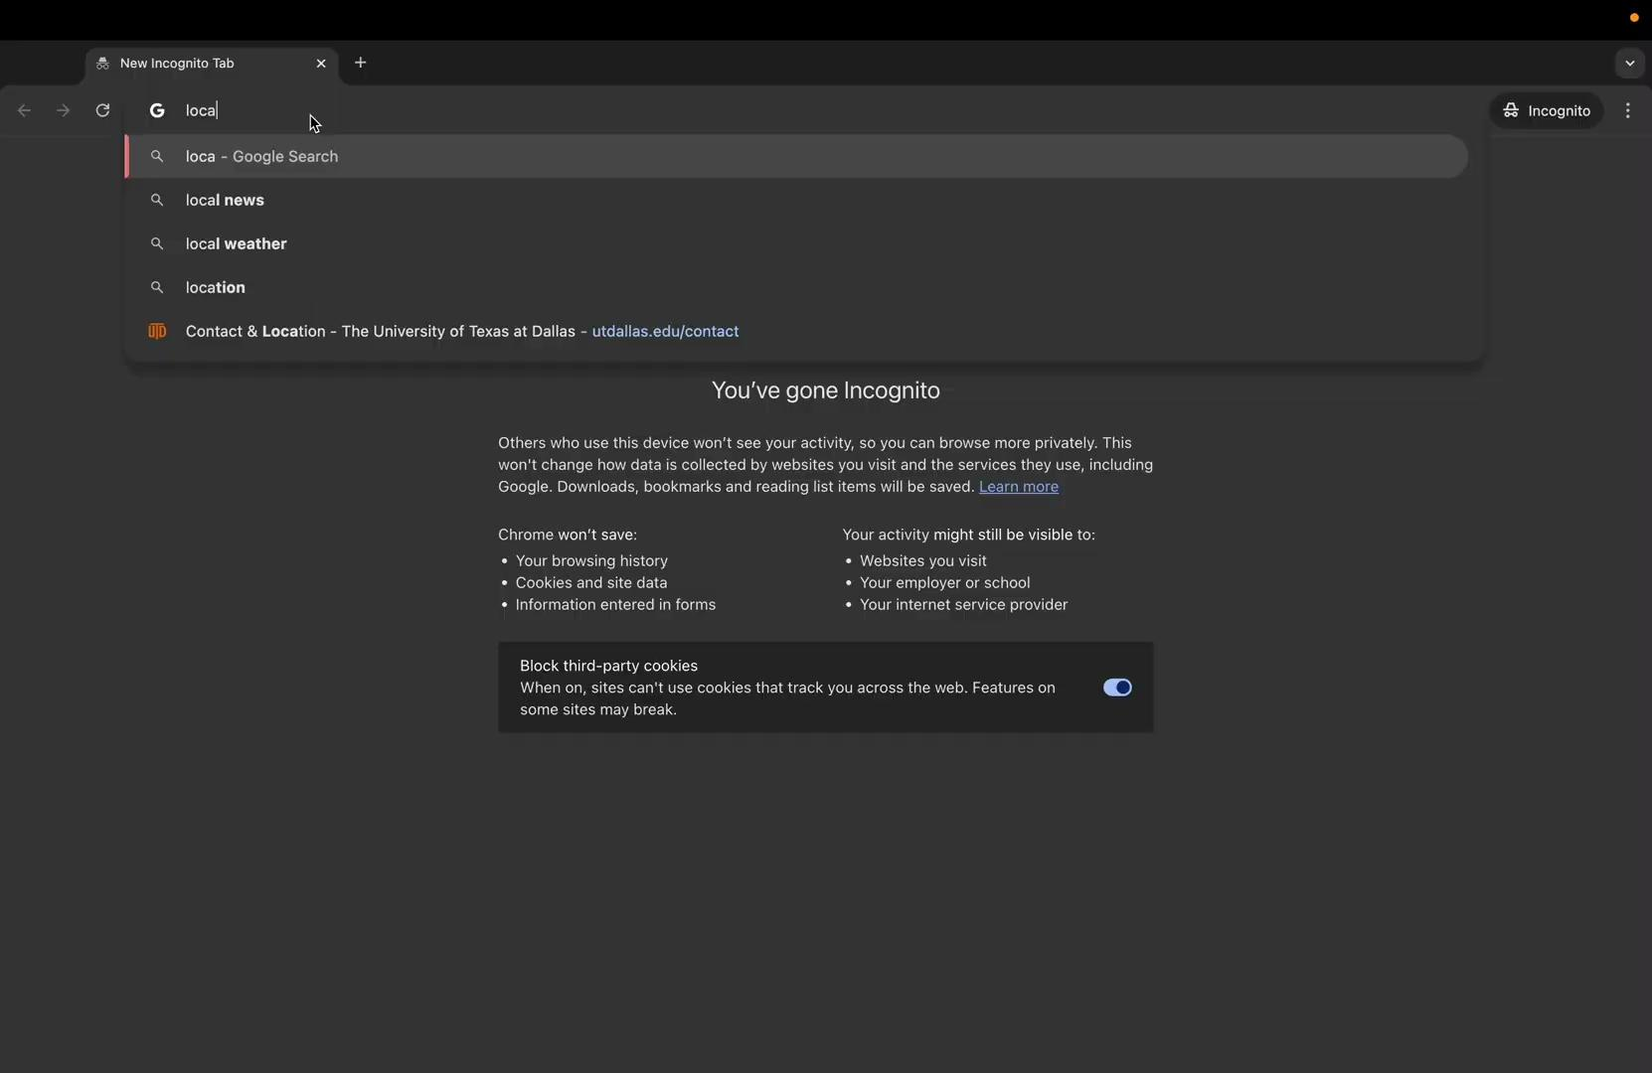
Live Demonstration!
L1
E1
T1
T1
B1
E1
D1
R1
Notes:
No video Dorrin

Slide 13
THANKS!
S1
H1
L1
E1
I1
L1
D1
L1
B1
Y1
E1
H1
O1
T1

